Slide 1
Drug Mortality and Socio-Economic conditions in Connecticut
Sandhya Govindaraju, Monica James, Yayun (Aaron) Liu, Alisha Pandhi

Slide 2
Project Description
We were looking to analyze trends in drug overdose death rates in Connecticut by:
Income
Age
Education
Gender
Geo-location (counties)
Unemployment rates
Barriers to medical treatment
Drug

Slide 3
Data Sources

Slide 4
Struggles with data
We were not able to find reliable data to analyze and plot these trends:
Drug-induced mortality rates and income
Drug-induced mortality rates and education

Slide 5
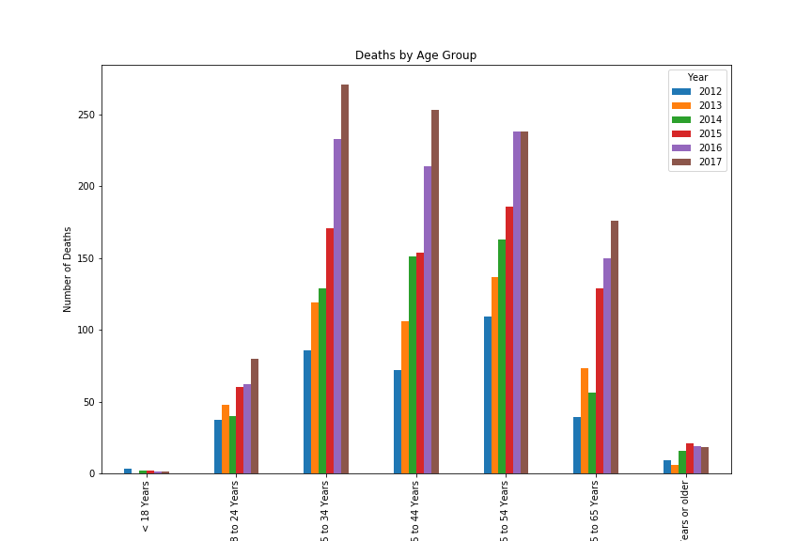
Drug-Induced Mortality Rates and Age

Slide 6
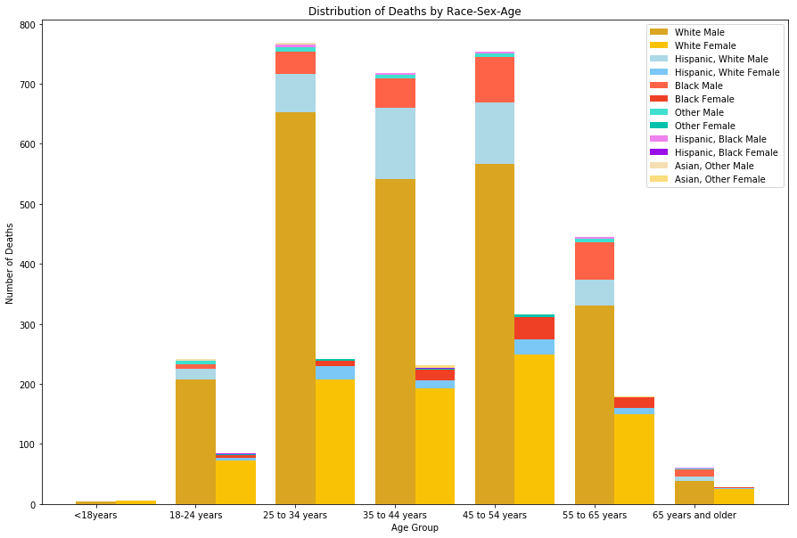
Drug-Induced Mortality by Gender, Race, and Sex

Slide 7
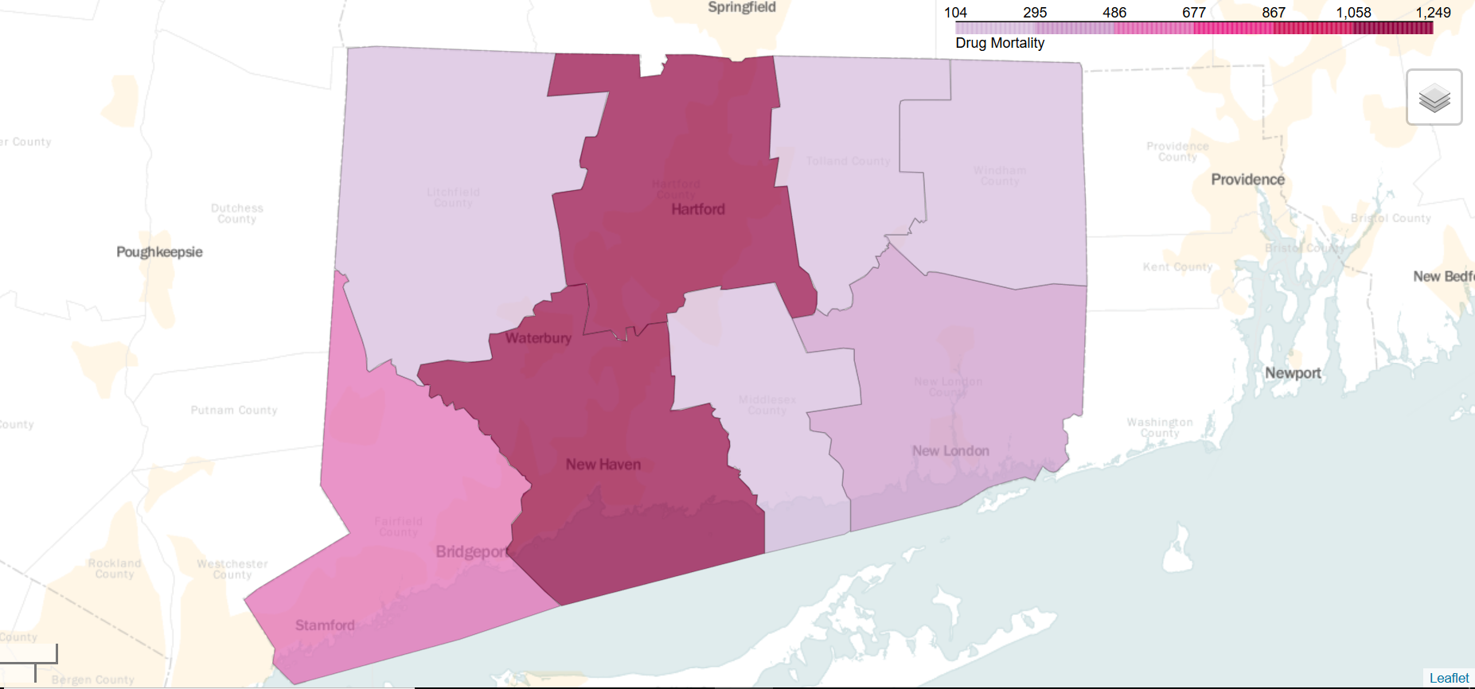
Drug-Induced Total Mortality by County

Slide 8
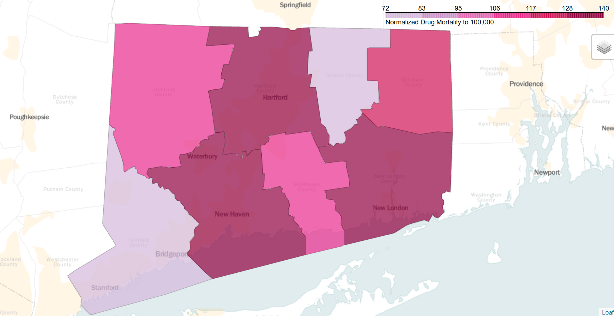
Drug-Induced Mortality by County per 100K

Slide 9
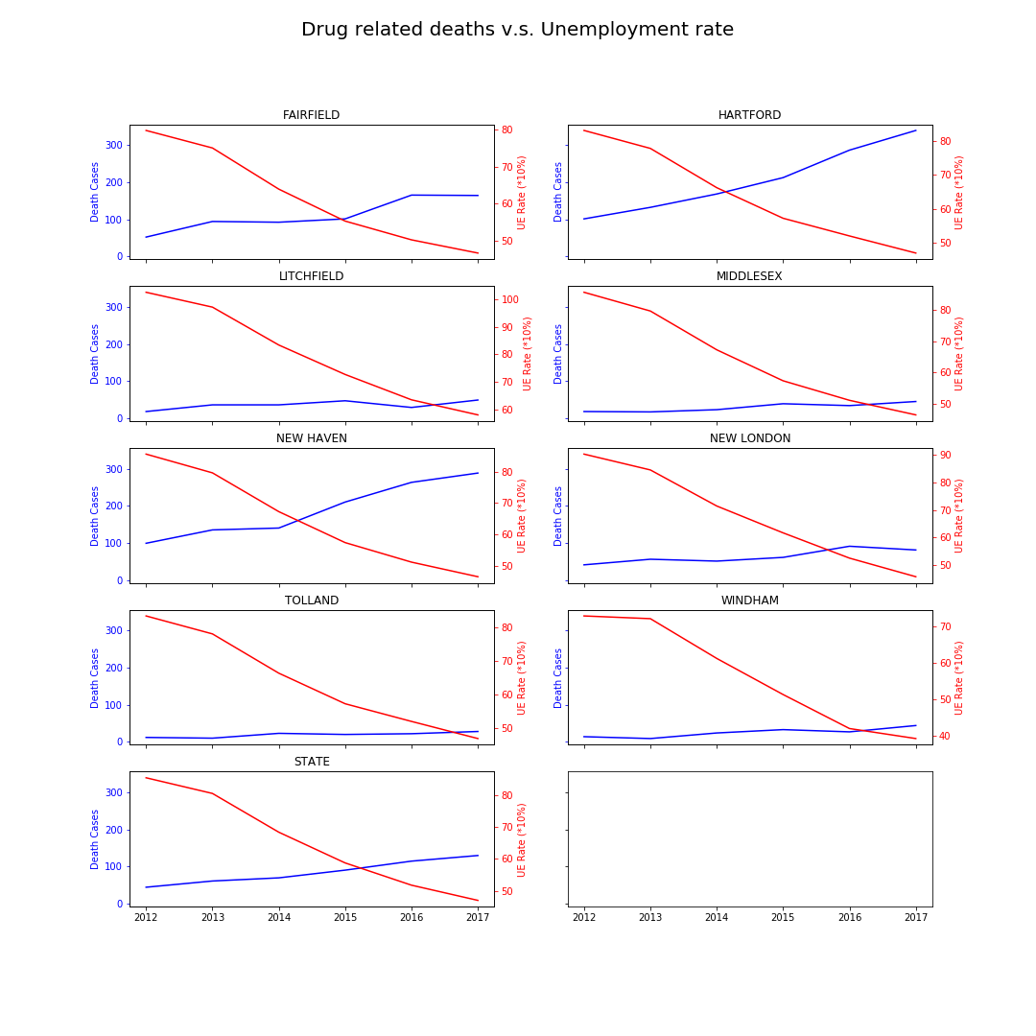
Drug-induced Mortality and Unemployment rates

Slide 10
Drug-induced mortality rates and barriers to medical treatment

Slide 11
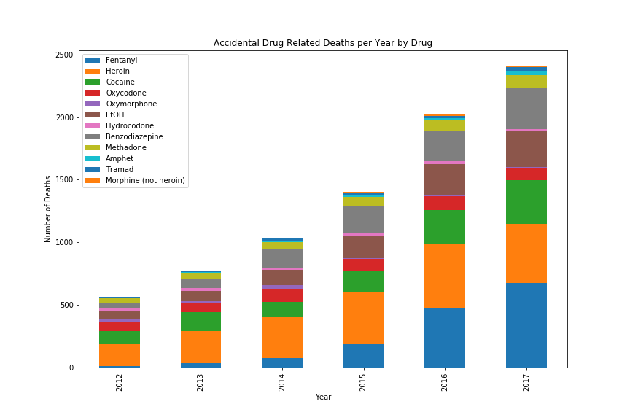
Drug-Induced Mortality Rates by Drug

Slide 12
Fentynal

Slide 13
Questions?

